Slide 1


ARDH KUMBH MELA 2027 · HARIDWAR
Chalo Kumbh
Official Digital Partner — Ardh Kumbh Mela 2027, Haridwar
150M+
45
Jan–Apr
Projected Pilgrims
Days of Divinity
2027

Slide 2
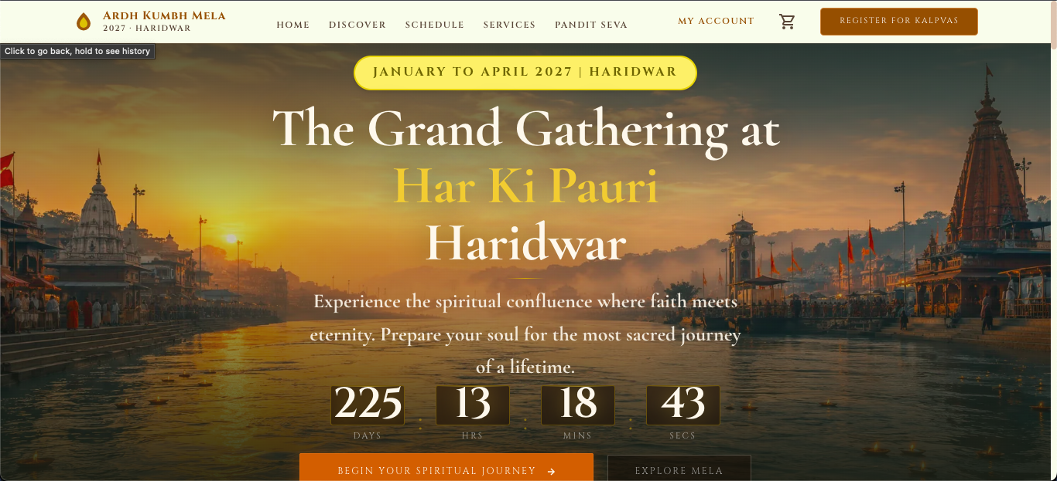
Chalo Kumbh
WHAT WE BUILT
The Official Digital Platform for Ardh Kumbh 2027
chalokumbh.com is a comprehensive web platform designed to digitise and elevate the Ardh Kumbh Mela 2027 experience — from ritual booking to environmental stewardship.
● Online Puja & E-Seva — Book sacred rituals and receive Prasad delivery worldwide
● Live Darshan Streaming — Watch ceremonies live from Har Ki Pauri via WebRTC
● Hotel & Stay Booking — Curated accommodations with real-time availability
● Green Haridwar — Environmental monitoring, volunteer drives & gamified challenges
● Multi-Portal System — Dedicated dashboards for Pandits, Hotels, and Admin
Chalo Kumbh · Ardh Kumbh Mela 2027 · chalokumbh.com

Slide 3
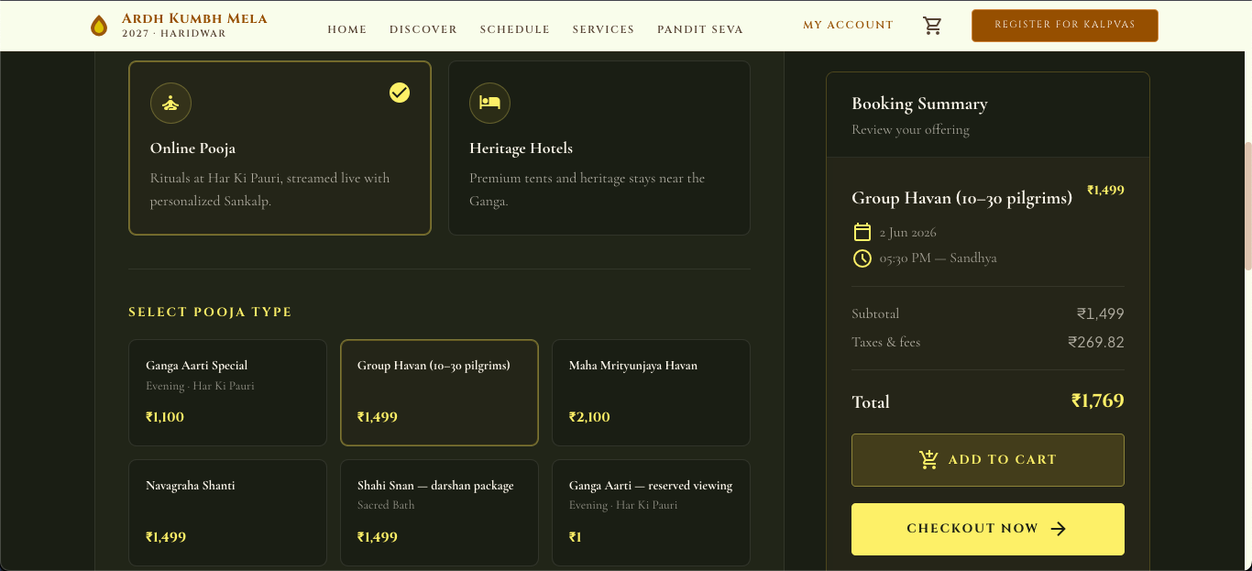
Chalo Kumbh
ONLINE PUJA & E-SEVA
Book Sacred Rituals from Anywhere in the World
Devotees can browse, customise, and book authentic Vedic rituals performed by verified pandits at Haridwar's sacred ghats — with live-streamed ceremonies and Prasad shipped to their door.
1. Choose Ritual
2. Select Date
3. Pick Pandit
4. Join Live
● 50+ Rituals Available — Ganga Aarti, Rudrabhishek, Satyanarayan & more
● Prasad Delivery — Sacred offerings shipped across India
● Personalised Sankalp — Custom prayer invocations with devotee's name & gotra
Chalo Kumbh · Ardh Kumbh Mela 2027 · chalokumbh.com

Slide 4
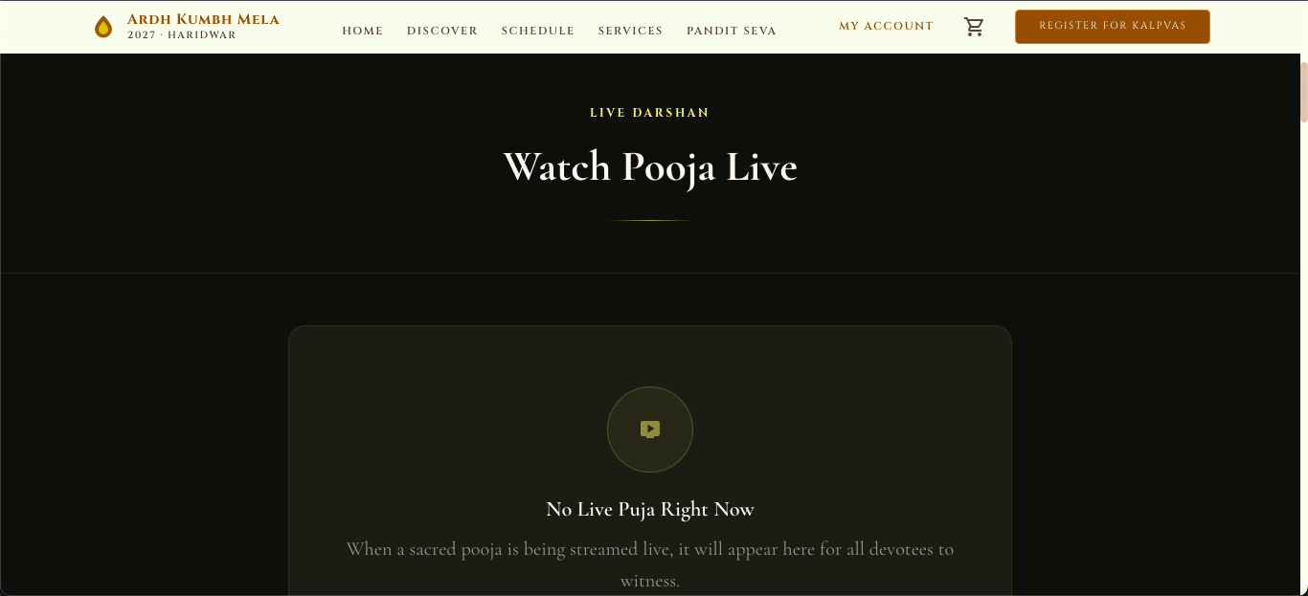
Chalo Kumbh
LIVE DARSHAN · REAL-TIME STREAMING
Watch Sacred Ceremonies Live — Worldwide
● Homepage Integration — Live stream embedded directly on the landing page
● No Login Required — Open access for millions of concurrent viewers
● QR Code Access — Scan-to-watch for on-ground pilgrims
● Admin Stream Control — Start, stop, and manage streams from the Company Portal
Technology: LiveKit Cloud · WebRTC · Viewer token auth · Multi-stream support
Chalo Kumbh · Ardh Kumbh Mela 2027 · chalokumbh.com

Slide 5
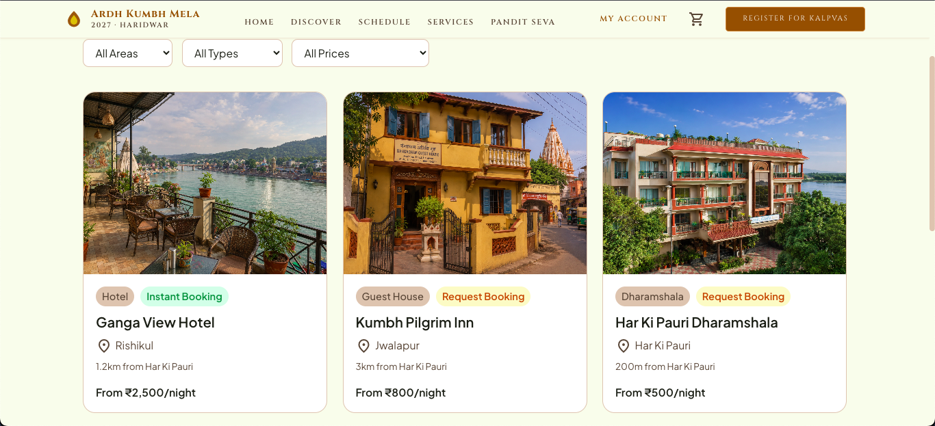
Chalo Kumbh
HOTEL & ACCOMMODATION BOOKING
Handpicked Stays Near Har Ki Pauri
● Smart Filtering — Search by location, price, amenities, and star rating
● Three Price Tiers — Budget, Standard, and Premium categories for every pilgrim
● Property Types — Hotels, Dharamshalas, Ashrams, and Boutique stays
● Commission Management — Transparent 10-18% tiered commission model
● Real-Time Availability — Live room inventory with instant confirmation
Chalo Kumbh · Ardh Kumbh Mela 2027 · chalokumbh.com

Slide 6
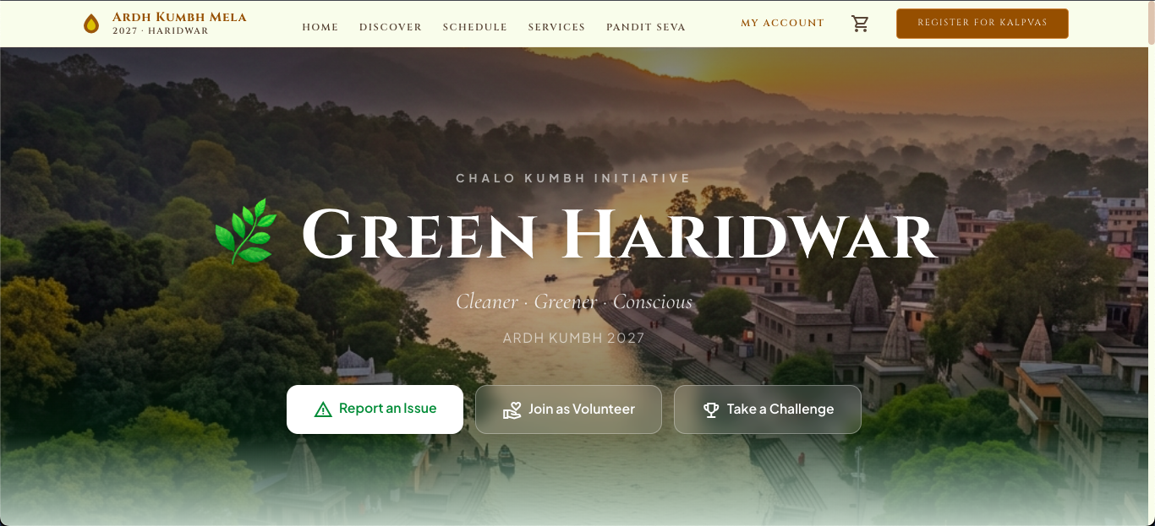
Chalo Kumbh
ENVIRONMENTAL INITIATIVE
Green Haridwar 🌿
Social Media Campaigns
Volunteer Drives
Green Challenges
Issue Reporting
Event Awareness
Partnering With
● Uttarakhand State Government
● National Mission for Clean Ganga (NMCG)
● Haridwar Municipal Corporation
● Local Environmental NGOs
Chalo Kumbh · Ardh Kumbh Mela 2027 · chalokumbh.com

Slide 7
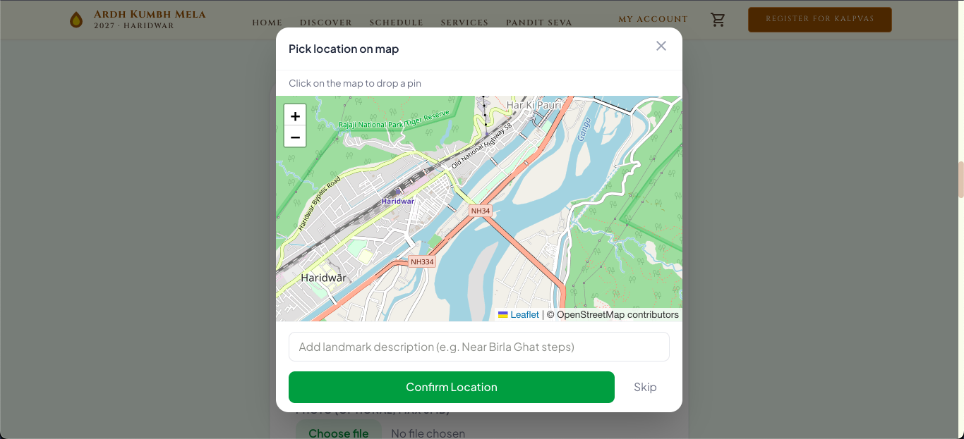
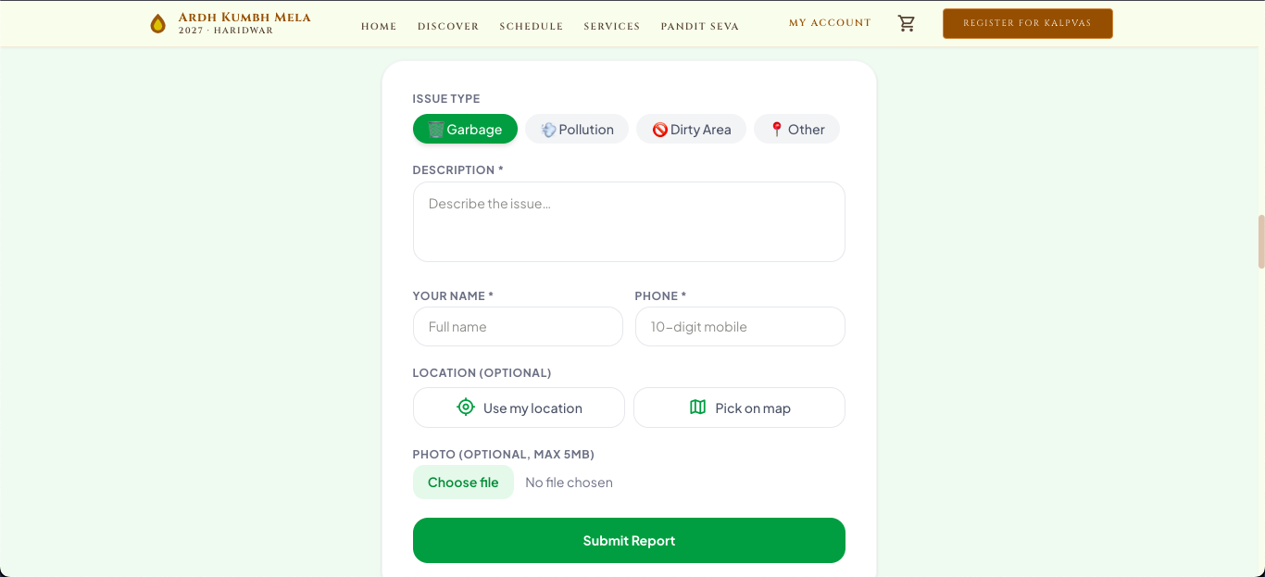
Chalo Kumbh
REAL-TIME ISSUE REPORTING
Citizen-Powered Environmental Monitoring
● 4 Issue Categories — Pollution, Waste Dumping, Water Quality, Encroachment
● Location Picker — Interactive map with GPS pin-drop for precise reporting
● Photo Upload — Visual evidence attached to every report
● Status Tracking — Real-time updates: Submitted → Under Review → Resolved
For Government & Authorities
Real-time environmental data dashboard enabling faster response times, resource allocation, and evidence-based policy decisions during the Mela.
Chalo Kumbh · Ardh Kumbh Mela 2027 · chalokumbh.com

Slide 8
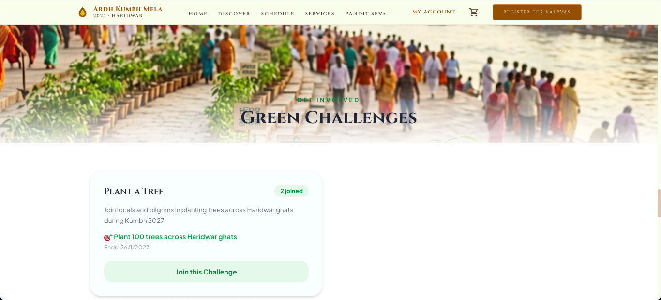
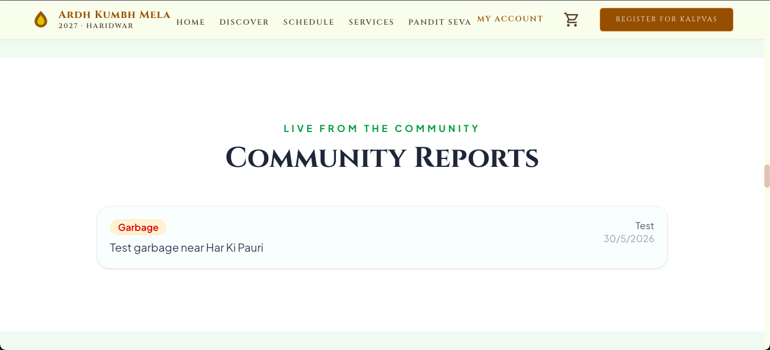
Chalo Kumbh
GREEN CHALLENGES & VOLUNTEER ENGAGEMENT
Gamified Sustainability for Mass Participation
● Photo-Verified Challenges — Participants submit evidence of eco-actions for approval
● Leaderboard & Rewards — Top contributors earn certificates and recognition
● Volunteer Registration — One-click sign-up for clean-up drives and tree planting
2,400+
12
Registered Volunteers
Active Challenges
Chalo Kumbh · Ardh Kumbh Mela 2027 · chalokumbh.com

Slide 9
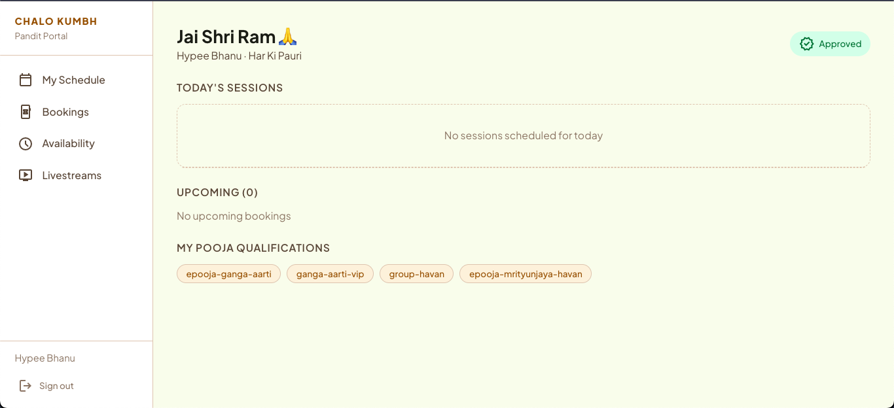
Chalo Kumbh
PANDIT PORTAL
Dedicated Dashboard for Registered Priests
● Booking Management — Accept, decline, and track incoming puja requests
● Weekly Availability — Set available dates and time slots for ceremonies
● Live Session Access — One-click join for live-streamed rituals via LiveKit
● Approval Workflow — Profile verification by admin before going live on platform
Chalo Kumbh · Ardh Kumbh Mela 2027 · chalokumbh.com

Slide 10
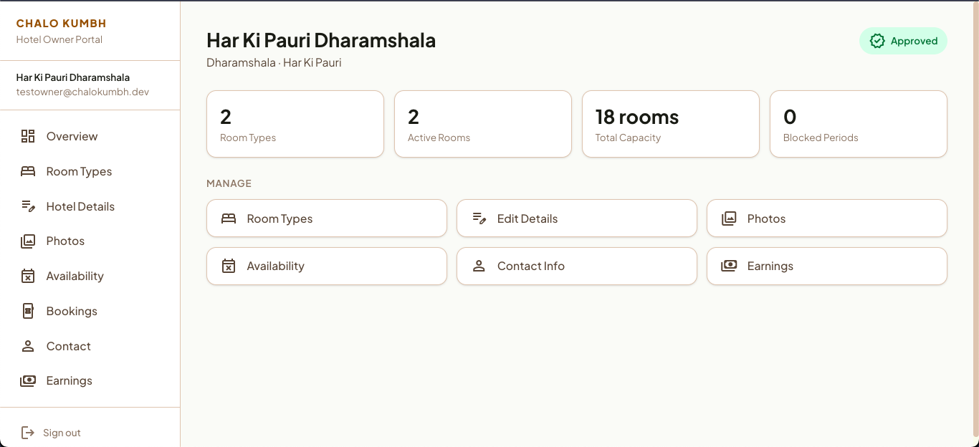
Chalo Kumbh
HOTEL PARTNER PORTAL
Self-Service Portal for Hotel Partners
● Room Type Management — Add and configure room categories, pricing, and capacity
● Availability & Date Blocking — Calendar-based inventory control with blackout dates
● Photo Gallery — Upload property and room images to attract bookings
● Earnings Dashboard — Track revenue, commissions, and payout history
Chalo Kumbh · Ardh Kumbh Mela 2027 · chalokumbh.com

Slide 11
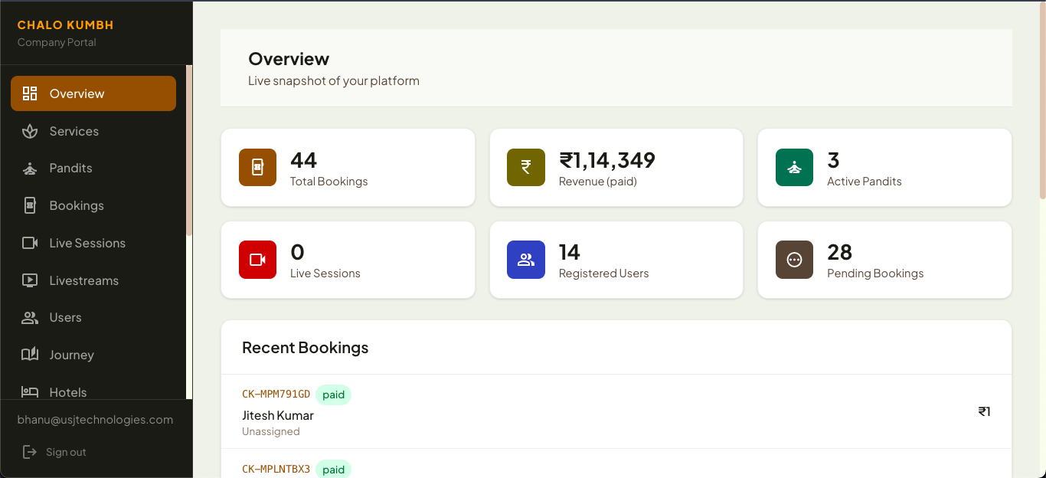
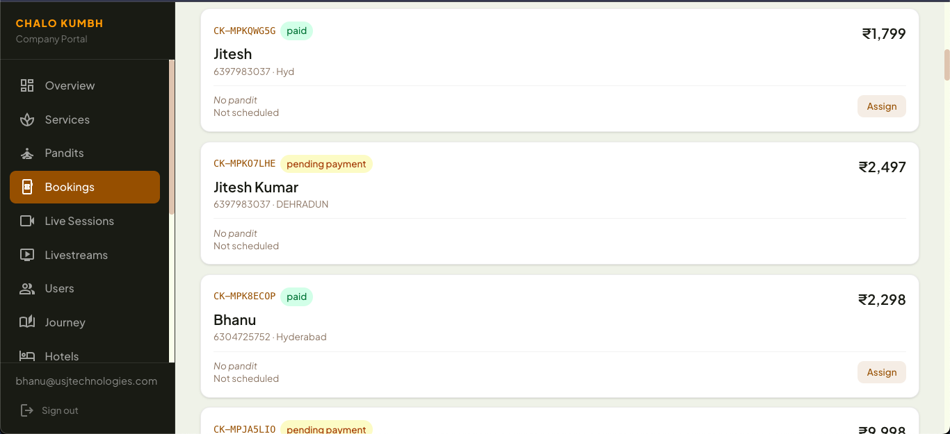
Chalo Kumbh
ADMIN · COMPANY PORTAL
Complete Platform Administration
● Platform Analytics — Real-time dashboards with booking volume, revenue & user metrics
● Pandit Approvals — Review, verify, and approve pandit registrations
● Livestream Management — Control live darshan streams — start, stop, multi-camera
● Marketing & Content — Manage homepage banners, promotions, and notifications
● Hotel Earnings — Commission tracking and payout management for all properties
Chalo Kumbh · Ardh Kumbh Mela 2027 · chalokumbh.com

Slide 12
Chalo Kumbh
PILGRIMAGE SERVICES
Everything a Pilgrim Needs — In One Platform
Service | Description | Key Features
Rituals & Pujas | Book authentic Vedic ceremonies online | 50+ rituals, verified pandits, Prasad delivery
VIP Ghat Access | Reserved spots at prime bathing locations | Priority entry, guided experience, safety escort
Premium Stays | Curated hotels and heritage properties | Budget to luxury, instant booking, real reviews
Satvik Meals | Traditional vegetarian meal plans | Pre-booked thalis, dietary customisation
Travel Assistance | End-to-end logistics and transport | Airport transfers, local cabs, route planning
24×7 Concierge | Round-the-clock pilgrim support | WhatsApp, call centre, multilingual agents
Veda Hydration | Branded purified water for pilgrims | Eco-friendly packaging, ghat distribution
Chalo Kumbh · Ardh Kumbh Mela 2027 · chalokumbh.com

Slide 13
Chalo Kumbh
WHY IT MATTERS
Digital Infrastructure for India's Largest Gathering
150M+
24×7
3
Projected Pilgrims
Support Coverage
Dedicated Portals
🇮🇳 Digital India Alignment
🌊 Swachh Bharat Alignment
● Paperless booking and digital payments for all services
● Real-time data dashboards for government authorities
● Scalable cloud infrastructure for 150M+ pilgrims
● Green Haridwar initiative for environmental monitoring
● Citizen-powered issue reporting with real-time tracking
● Gamified volunteer engagement for cleanliness drives
Chalo Kumbh · Ardh Kumbh Mela 2027 · chalokumbh.com

Slide 14
HAR HAR GANGE · JAI GANGA MAIYA
Together, Let Us Make Kumbh 2027 Extraordinary
Platform: chalokumbh.com
Built By: USJ Technologies
Contact: techteam@usjtechnologies.com

